Slide 1
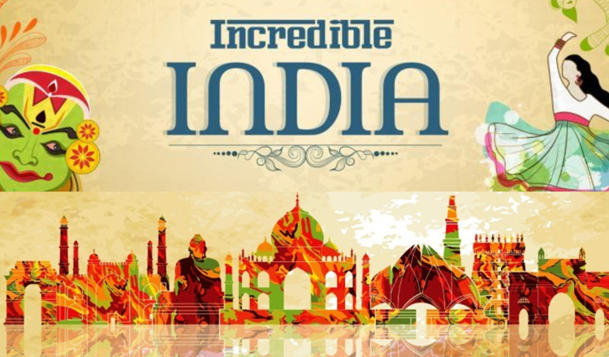

Slide 2
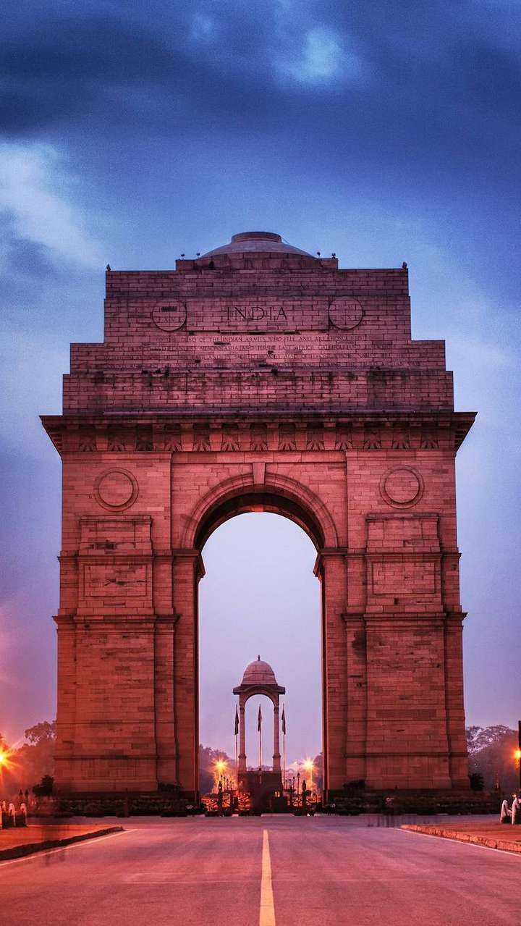
Contents
Introduction
A short film on Incredible India
Why India is called “Incredible India”
Indian Culture and Tradition
Kerala Tourism
Gujarat Tourism
Himachal Pradesh
References

Slide 3

Incredible India is the name of an international tourism campaign maintained by the Government of India since 2002, to promote tourism in India.
The campaign portrayed India as an attractive tourist destination by showcasing different aspects of Indian culture and history like yoga, spirituality, etc.

Slide 4
Popular persons like Amitabh Bacchhan and Amir Khan were taken as the Brand Ambassadors for the campaigns.
Tourism in India is a major source of employment for people coming from a different strata of society. It also adds to the country’s GDP and has made India one of the fastest-growing Asian countries in the world. It was seen that the diversity of India if promoted in the right way, could help immensely to boost our tourism.
The Incredible India slogan originated from the rich cultural diversity of the country. With so many languages, festivals, and people it was fit to call India as – The Incredible India.

Slide 5
Reasons why India is called Incredible India
Numerous aspects make India Incredible. With its rich diversity of various languages, cultural heritage, and traditions, India has something for everyone. Tourists feel home in this land of warmth and love. Here are the top things that make India Incredible.

Slide 6
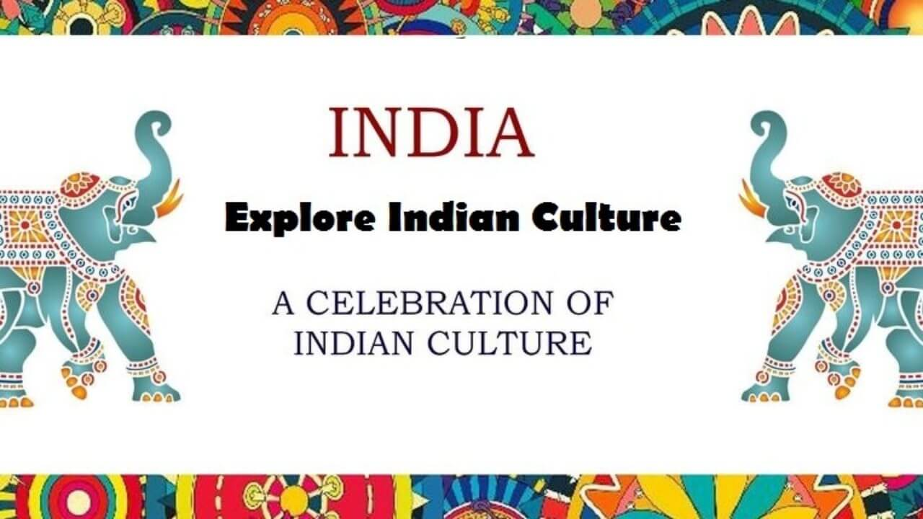
EXPLORE INDIAN CULTURE
AND
TRADITION
A CELEBRATION OF INDIAN CULTURE AND TRADITION

Slide 7
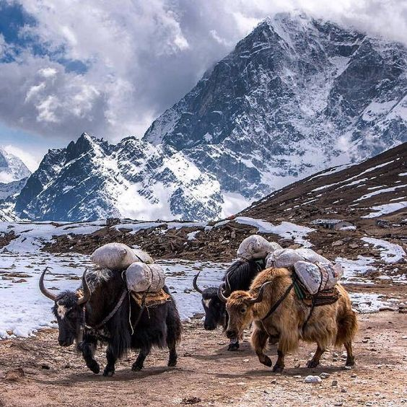
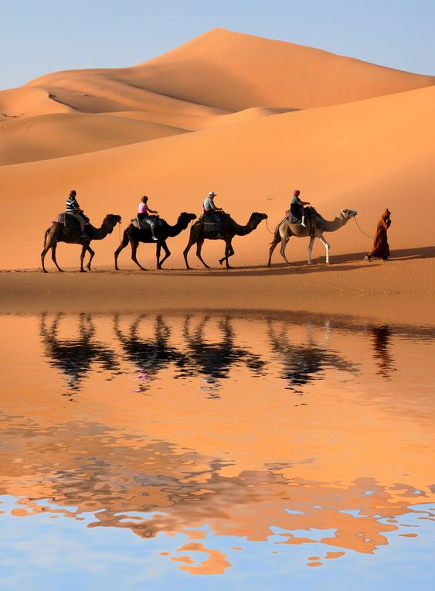
Topography
India is a country with various geographical terrains.
The Great Himalayan Range
The Never-Ending Deserts:
The Lush Fertile Plains:
Rich Plateaus:

Slide 8
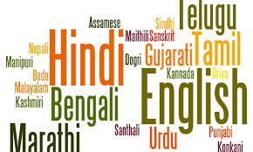
Languages
The language in India is extremely diverse. Changing cities leads to change in the local dialect. Hindi though spoken in most of the states also has a touch of the local region.
Maharashtrians speak Marathi, Punjabis speak Punjabi and likewise, all states have their own languages.
The southern states also have diverse languages like Kannada, Telugu, Malayalam, and Tamil. These languages are spoken within the state only.
Hindi and English are spoken throughout India. Tourists visiting India, therefore, do not face any trouble.

Slide 9
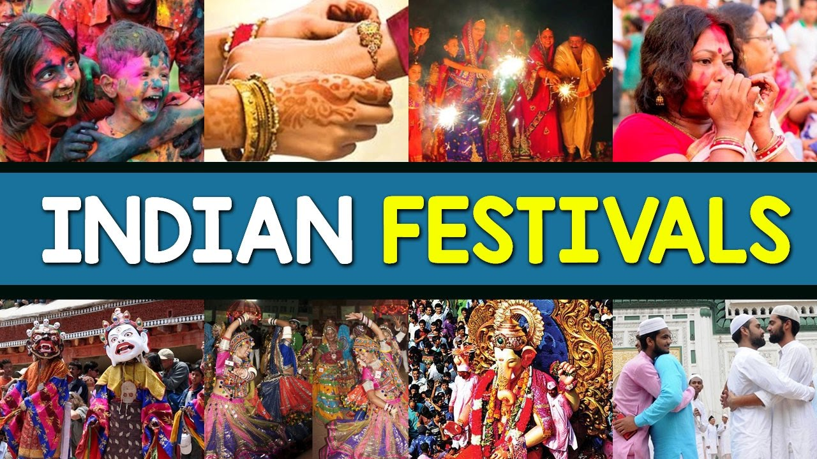
Festivals
Diwali and Holi are the two major Hindu festivals celebrated all over India. People of all religions celebrate festivals with equal fervor.
Christmas is the popular Christian festival celebrated on the 25th of December on the birth of Christ.
Eid is the major Muslim festival celebrated all over India. People hug each other on this occasion and promote peace and harmony.
Gurupurab, Guru Purnima is the Sikh festival celebrated with full enthusiasm and zenith. Baisakhi is another Sikh, Punjabi festival which celebrates the harvest season.

Slide 10
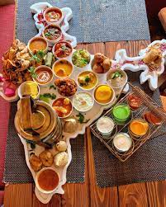
Food
For all the foodies out there, India is the country to visit for trying out a variety of different delicacies.
The Rajma chawal, Rogan Josh in Kashmir to the Chole Bhature in Punjab.
Fish curries in Bengal, idli dosa in South India, Butter chicken in Delhi, Punjab are few examples of famous delicacies.
Street food sold in the narrow lanes of India is mouthwatering and tasty.

Slide 11
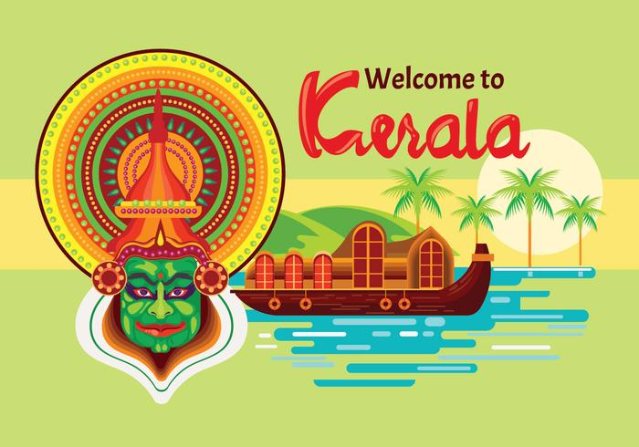
Festivals
Food
Kerala Tourism
Dance

Slide 12
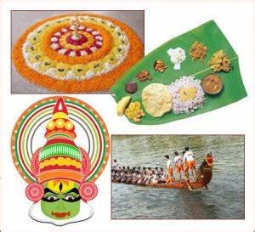
National Festival of Kerala : ONAM
Onam is an annual Indian harvest festival celebrated predominantly by the Hindus of Kerala.
This festival falls in August-September and has a wonderful story attached to it.
Onam is a very important festival to the people of Kerala and has been celebrated in a grand manner every year.

Slide 13
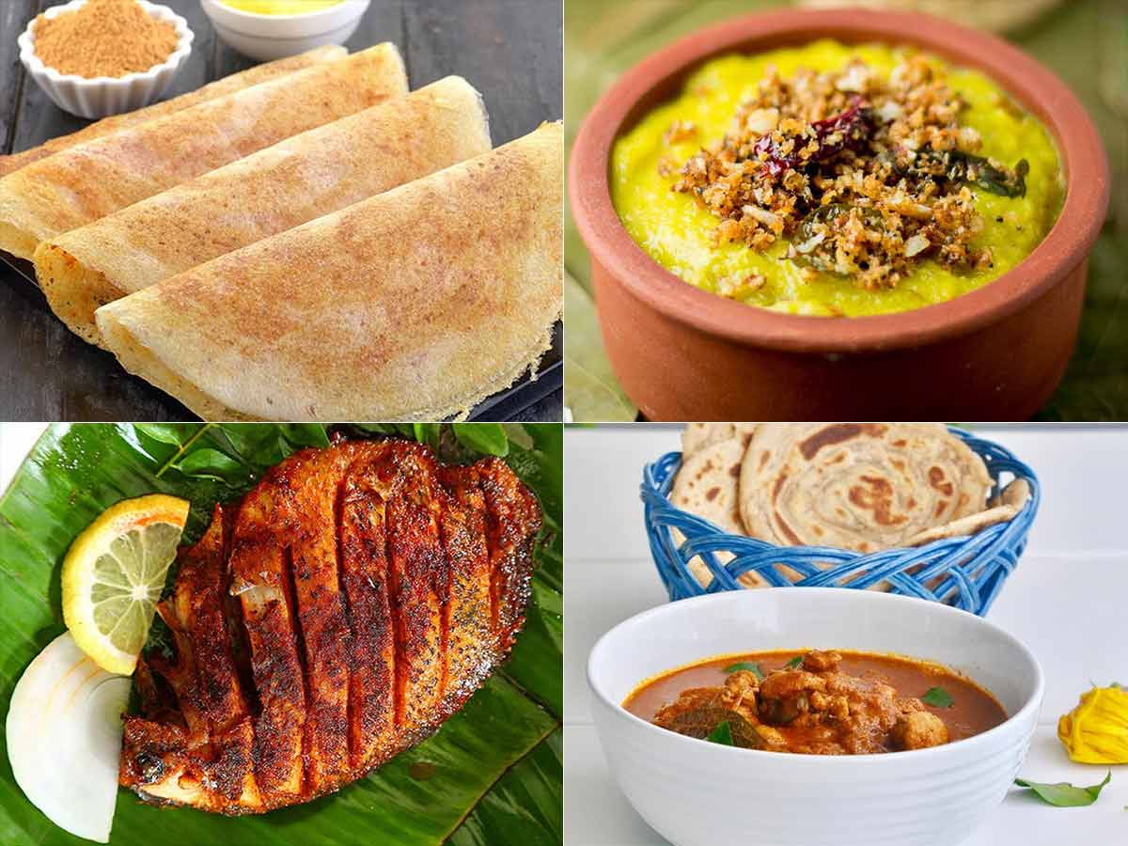
Kerala Cuisine
Idli Sambar
Prawn Curry
Malabar Parota
Idiyappam With Curry
Puttu And Kadala Curry

Slide 14
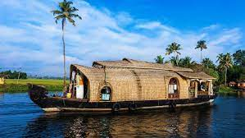
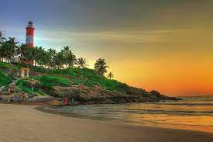
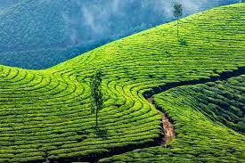
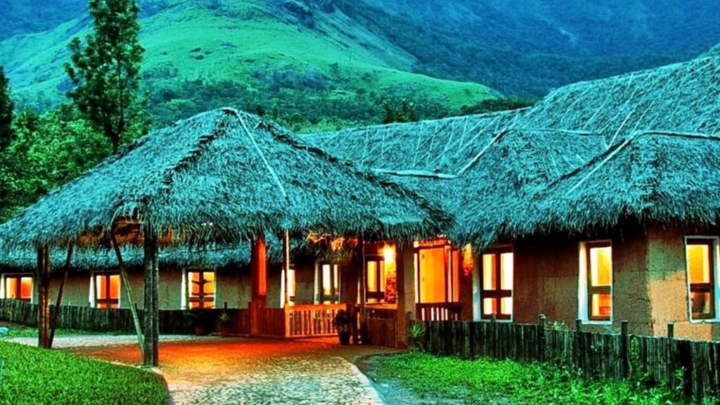
Alleppey.
Kovalam
Kerala tourism
Munnar
Wayanad

Slide 15
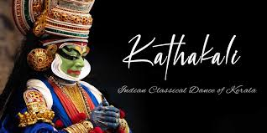
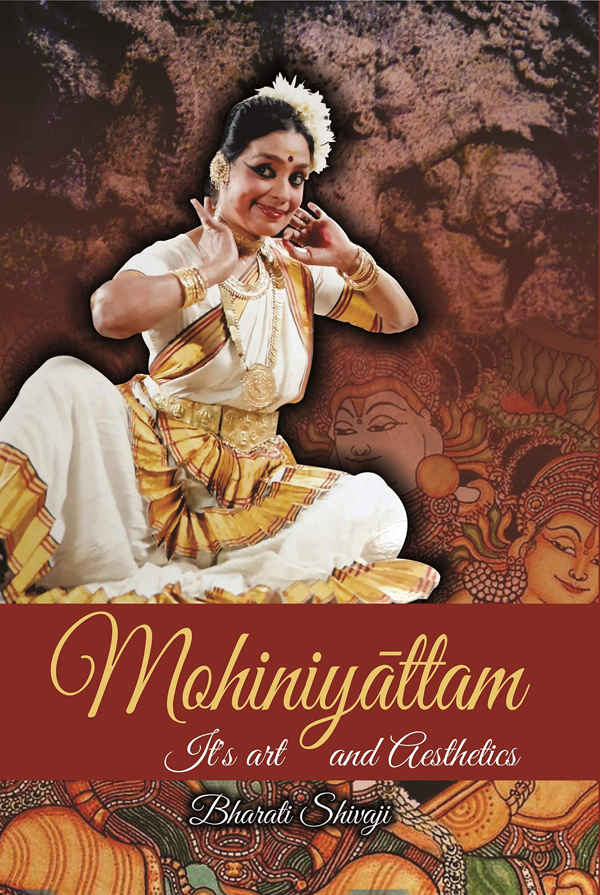
Famous classical dances of KERALA
Munnar
Wayanad

Slide 16
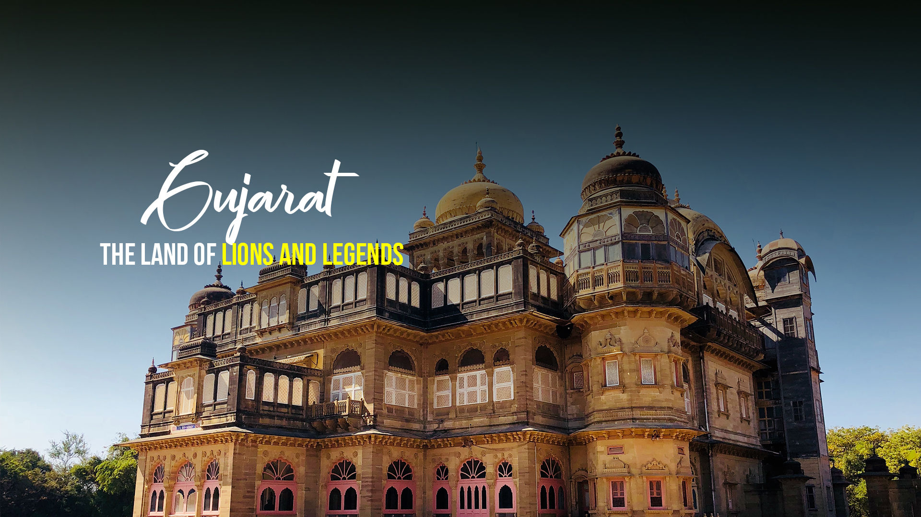
Festivals
Food
Gujarat Tourism
Dance

Slide 17
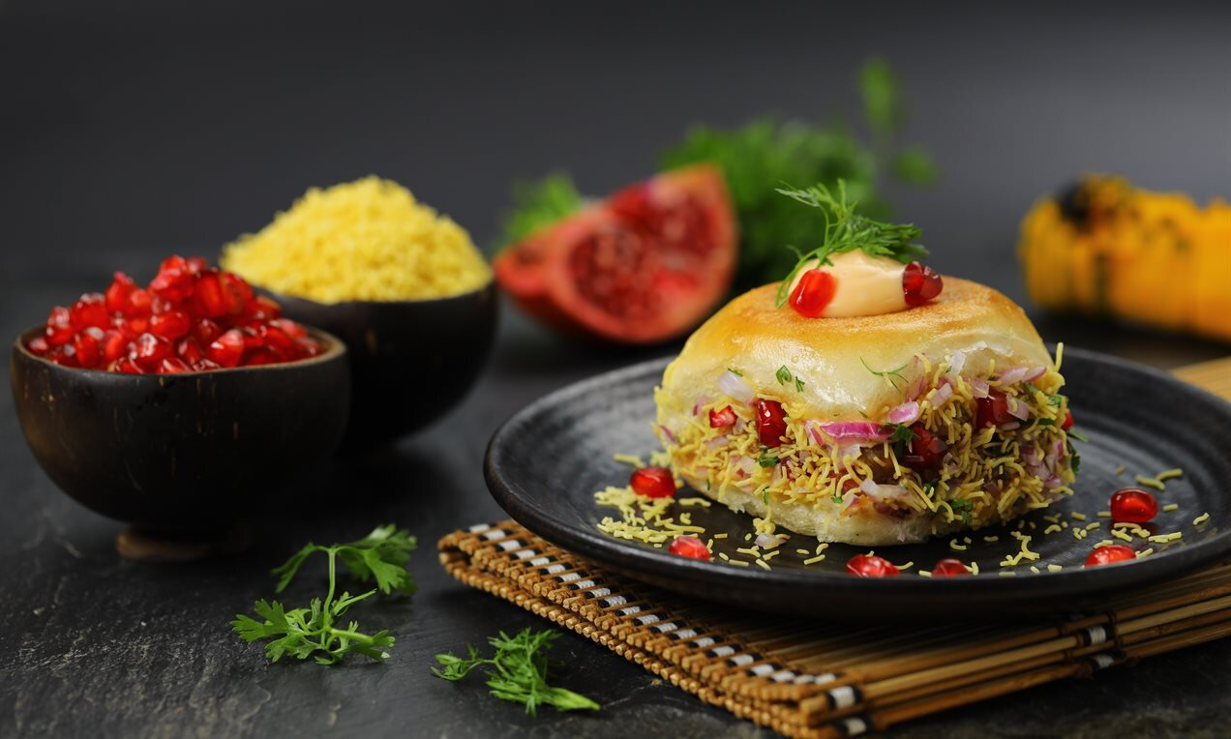
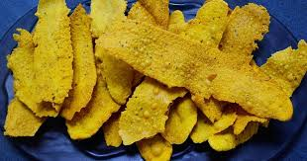
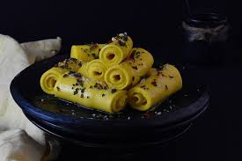
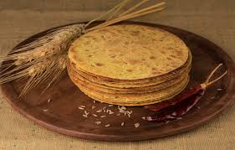
Dabeli
Fafda
Gujarati Cuisines
Khandvi
Khakhra

Slide 18
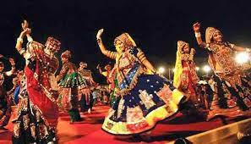
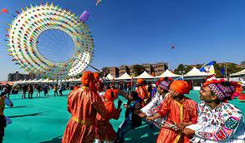
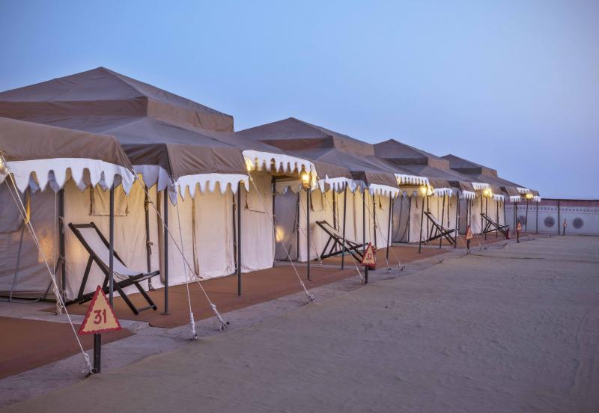
Famous Festivals of Gujarat
Navratri
Makar Sakranti
Rann Utsav

Slide 19
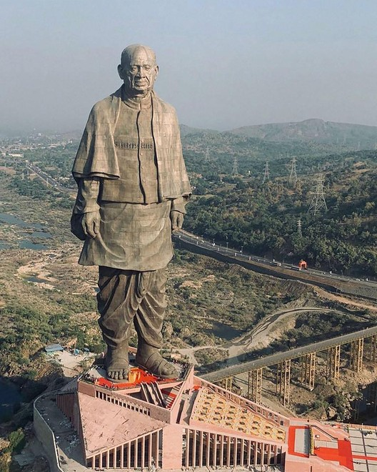
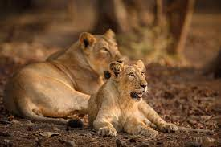
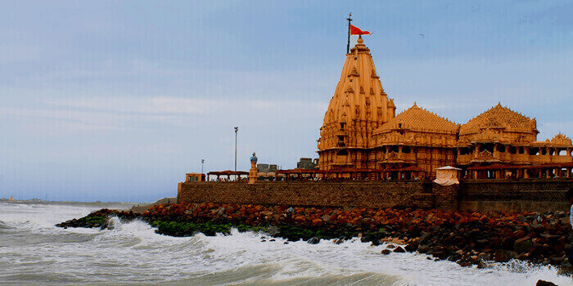
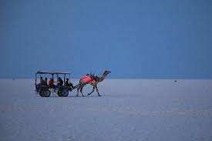
Statue of Unity
Gir National park
Gujarat Tourism
Somnath Temple
Rann of Kutch

Slide 20
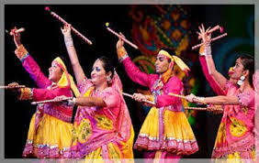
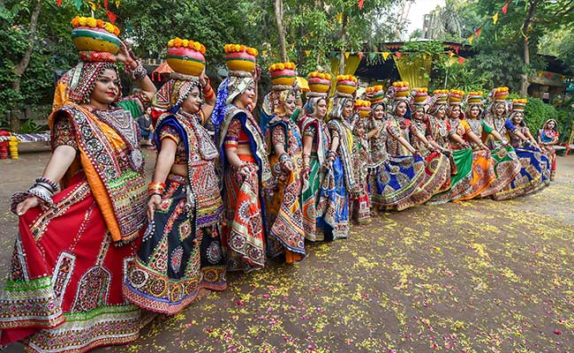
Gujarat Dance
The most famous folk dance of Gujarat is Garba and Dandiya.
Dandiya
Garba

Slide 21
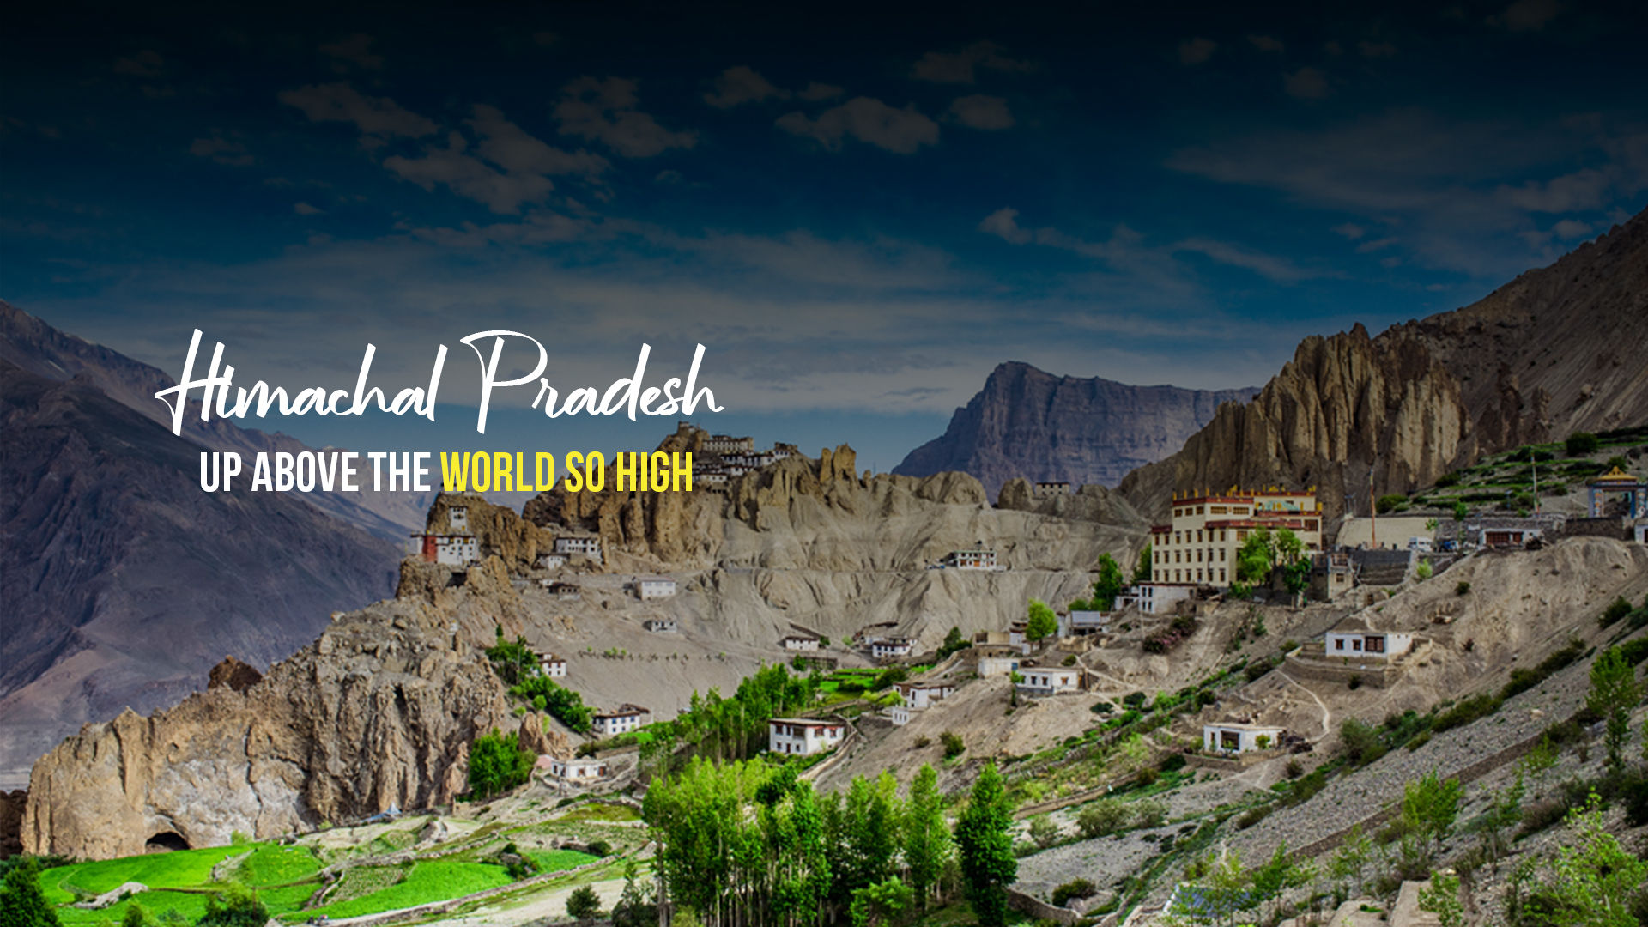
Festivals
Food
Tourism
Dance

Slide 22
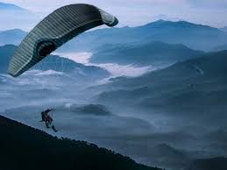
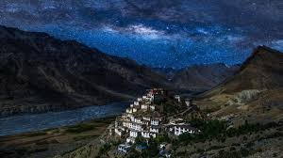
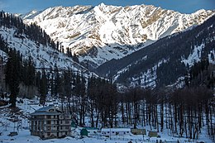
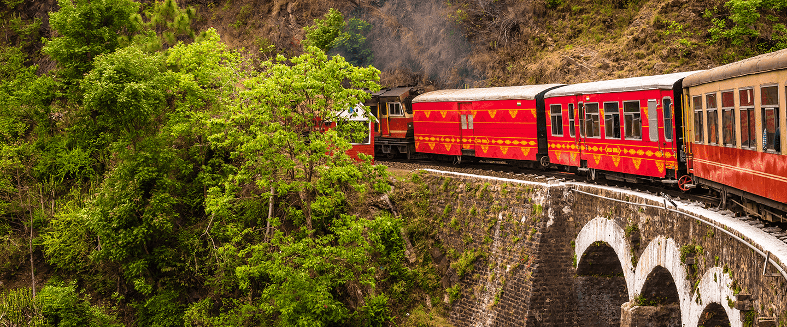
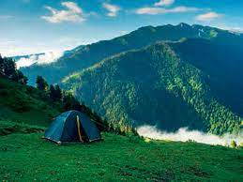
Bir Billings
Spiti Valley
Himachal Pradesh Tourism
Manali
Shimla
Kasol

Slide 23
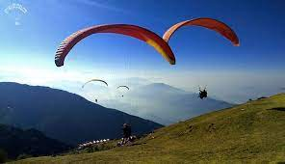
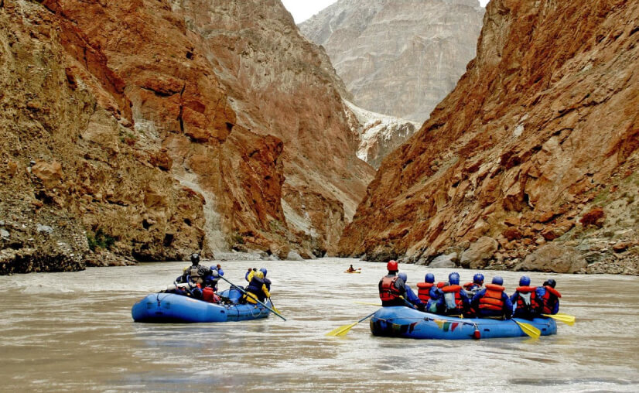
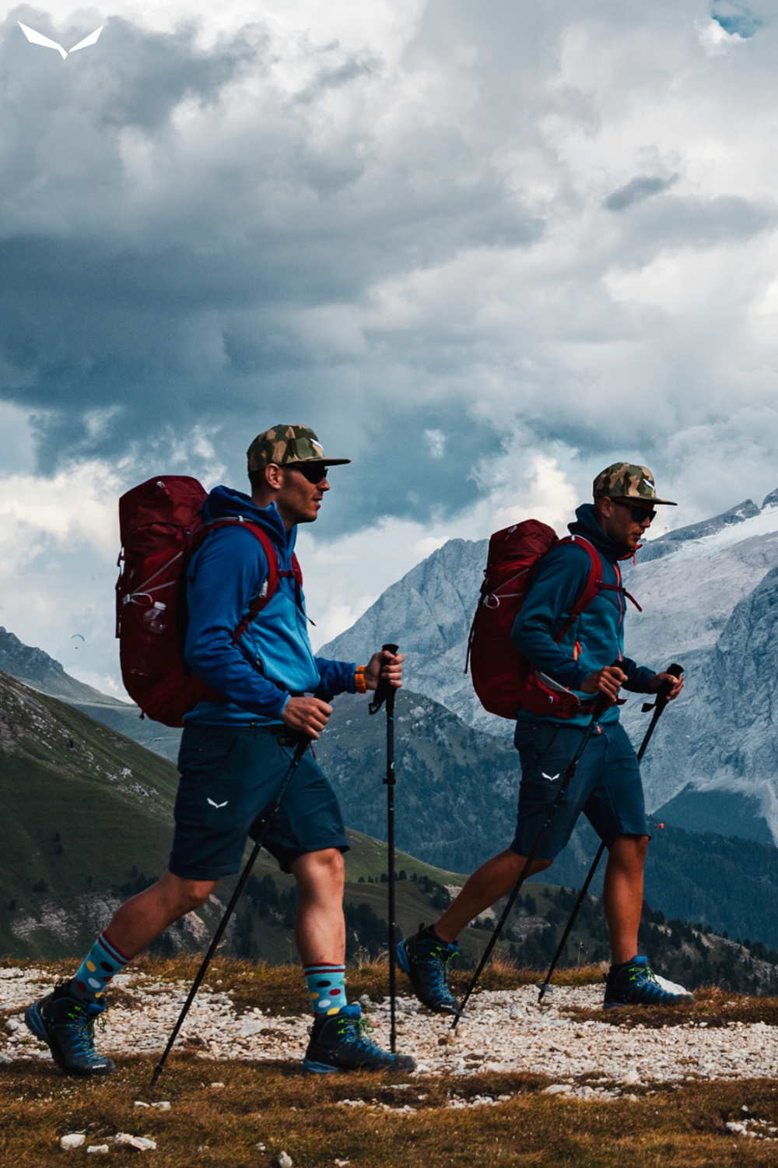
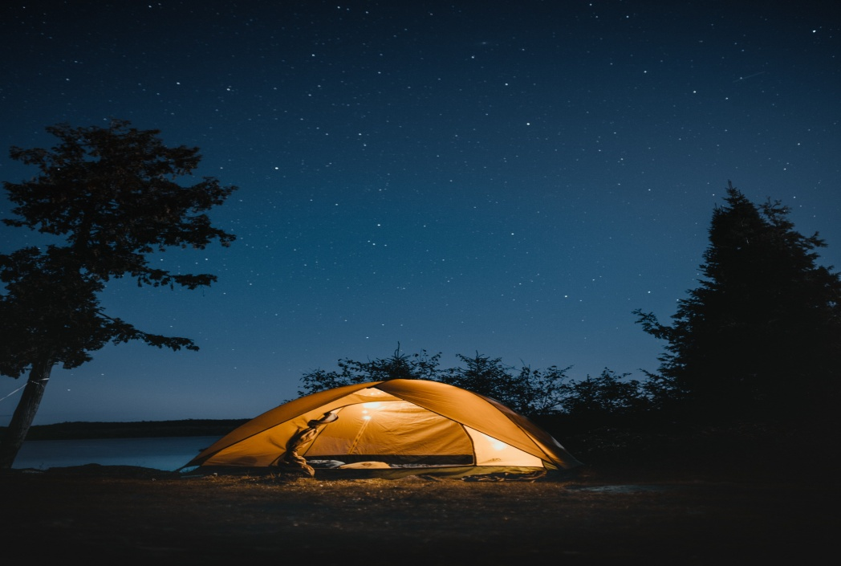
Paragliding
River Rafting
Adventures in Himachal Pradesh
Trekking
Camping

Slide 24
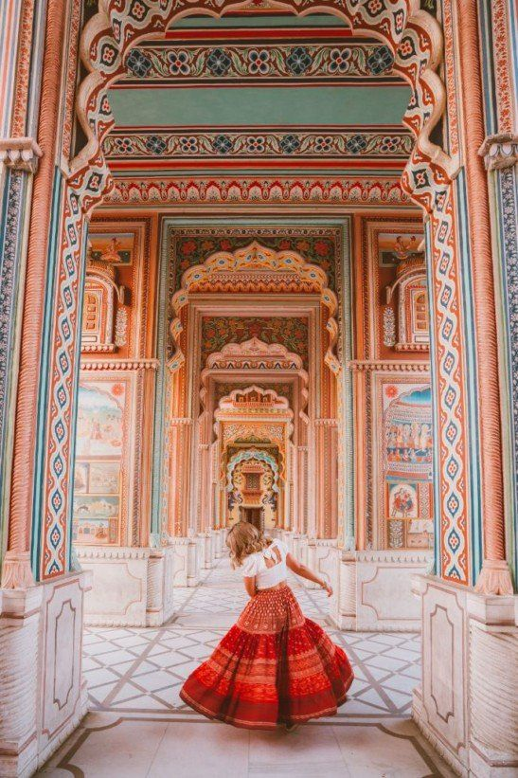
Rajasthan
Festivals
Food
Tourism
Dance

Slide 25
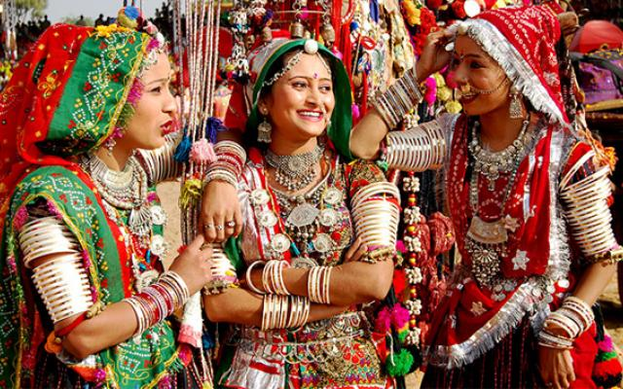
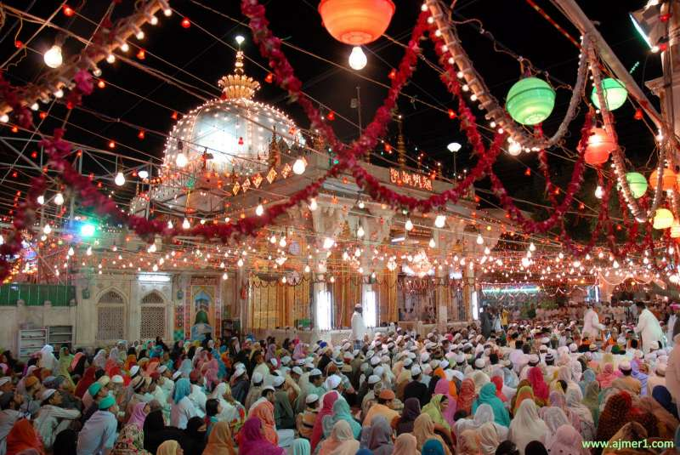
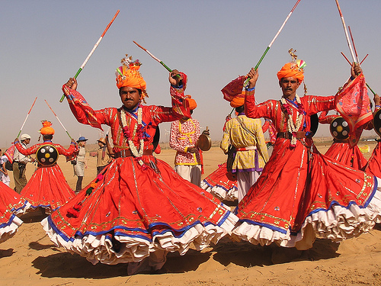
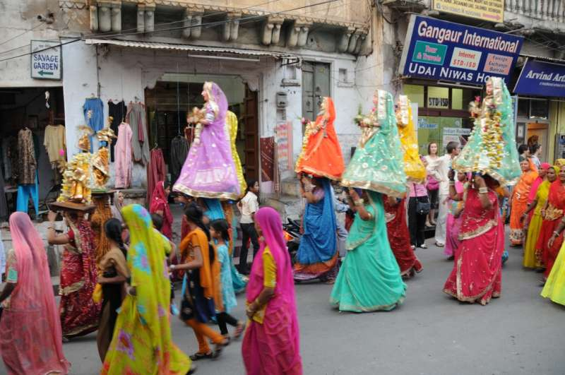
Teej Festival, Jaipur
Urs Festival
Rajasthan Festivals
Desert Festival,Jaisalmer

Slide 26
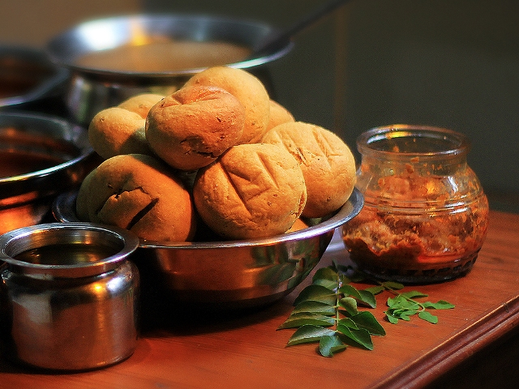
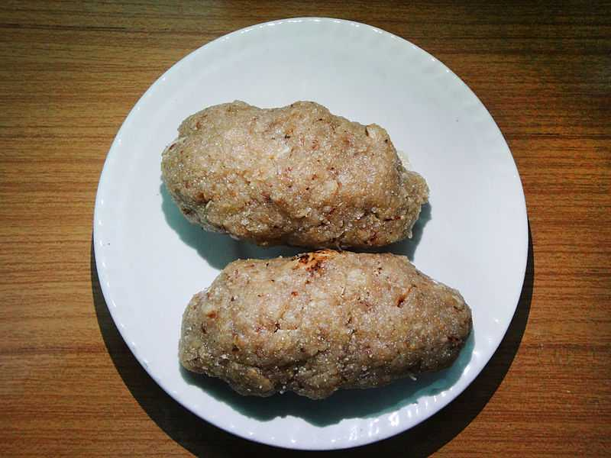
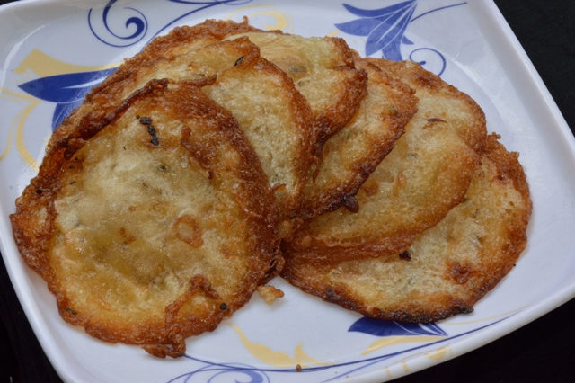
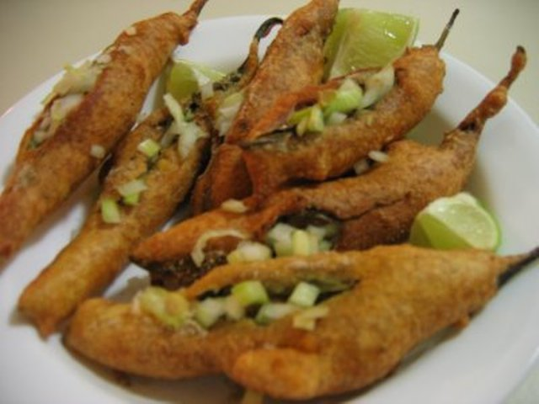
Dal Bati
Churma
Rajasthan cuisines
Malpua
Mirchi bada
Mal Pua
Mirchi Bada

Slide 27




Hawa Mahal
Nahargarh Fort
Rajasthan Tourism
Birla Mandir
Udaipur

Slide 28




Bhavai
Kathputli
Famous Dances of Rajasthan
Ghoomar
Kalbelia

Slide 29

A short film on Incredible India

